Slide 1
Swarm Intelligence Based Maze Solver​
069/BEX​
Digya Acharya​
Pranish Bhagat​
Pratik Bhandari​
Sijan Bhattarai​

Slide 2
CONTENTS
Swarm Robotics
Maze Solving
Swarm Intelligence
Wireless Communication
Target Detection

Slide 3
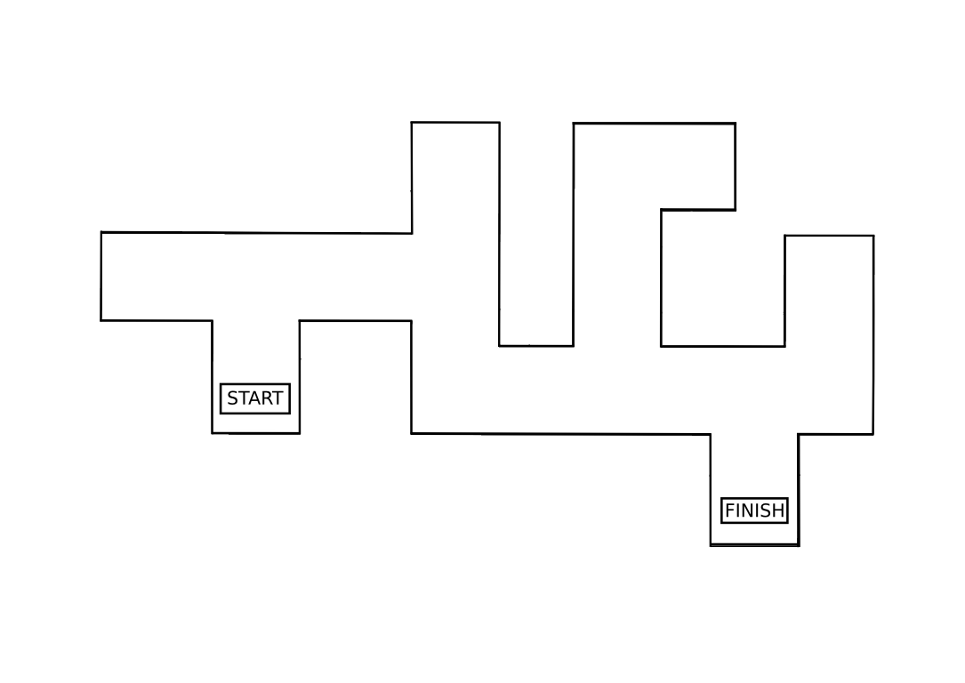
Can you guess the Shortest Path?

Slide 5






Slide 6
MAZE
TARGET
SWARM
WIRELESS
INTELLIGENCE

Slide 7
Swarm
Design of group of robots that operate without any form of centralized control
Using local methods of control and communication
Local control – autonomous operation
Local communication – avoids bottlenecks
Scalable – new robots can be added, or fail without need for recalibration
Simplicity – cheap, expendable robots
Self-organization

Slide 8
APPPLICATIONS
Search And Rescue ( SAR) Operation.
Disaster Relief
Landmine Detection and further operations

Slide 9
WHY?
Efficient use of resource
Autonomous navigation
Work Division
De-centralization
Unknown terrain navigation
Notes:
Best possible us of resouce

Slide 10
PROBLEM STATEMENT
To demonstrate the concept of swarm intelligence by solving a maze
Notes:
A robot with very simple and plain characteristics can be made intelligent with the concept of swarm

Slide 11
Methodology

Slide 12
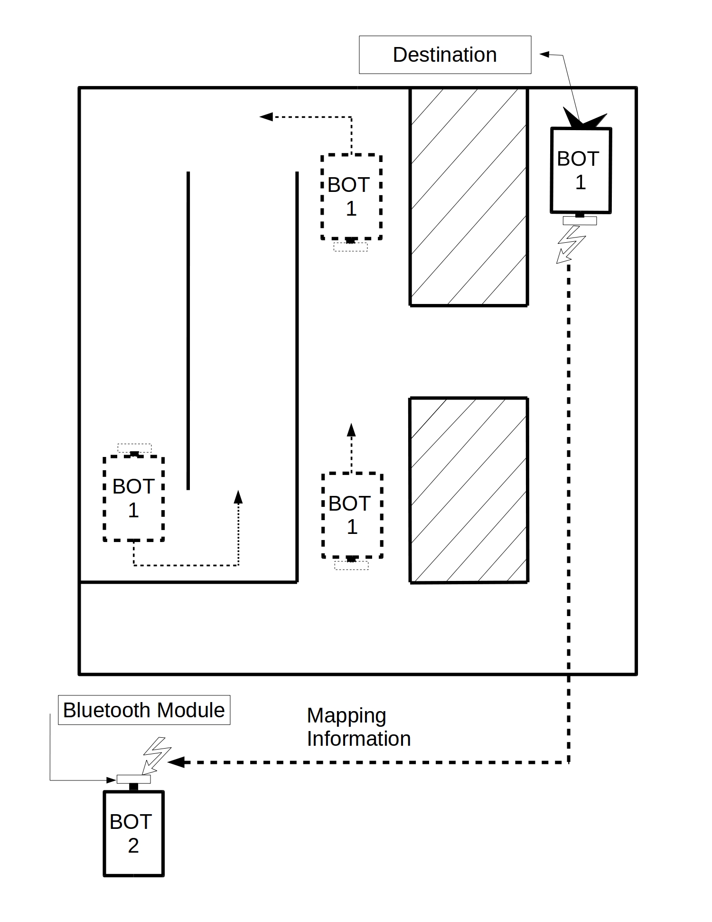
First Robot
Traverse with mistakes
Relay suitable information
Second Robot
- Traverse in shortest possible
path
System Architecture
Notes:
Both robots don’t traverse the maze at the same time
Are not present in the field at the same time

Slide 13
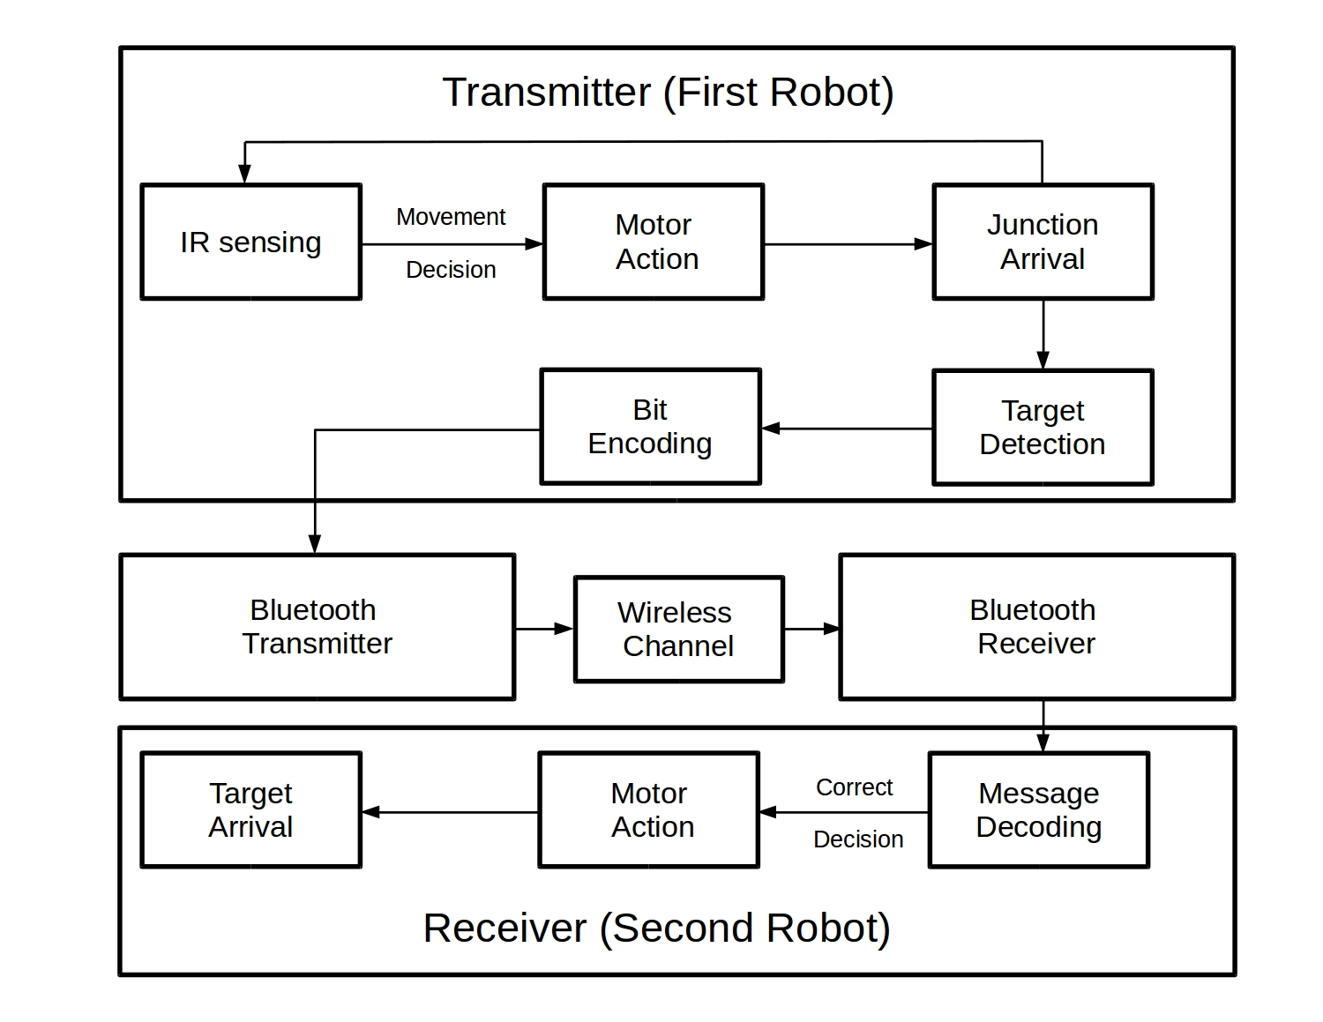

Slide 14
FUNCTIONAL OVERVIEW
The first robot traverses the entire maze using the left wall algorithm generating mistakes along the path.
The encoded messages i.e. decisions at the junction is then sent to the second robot which then traverses the maze in the shortest path possible.

Slide 15
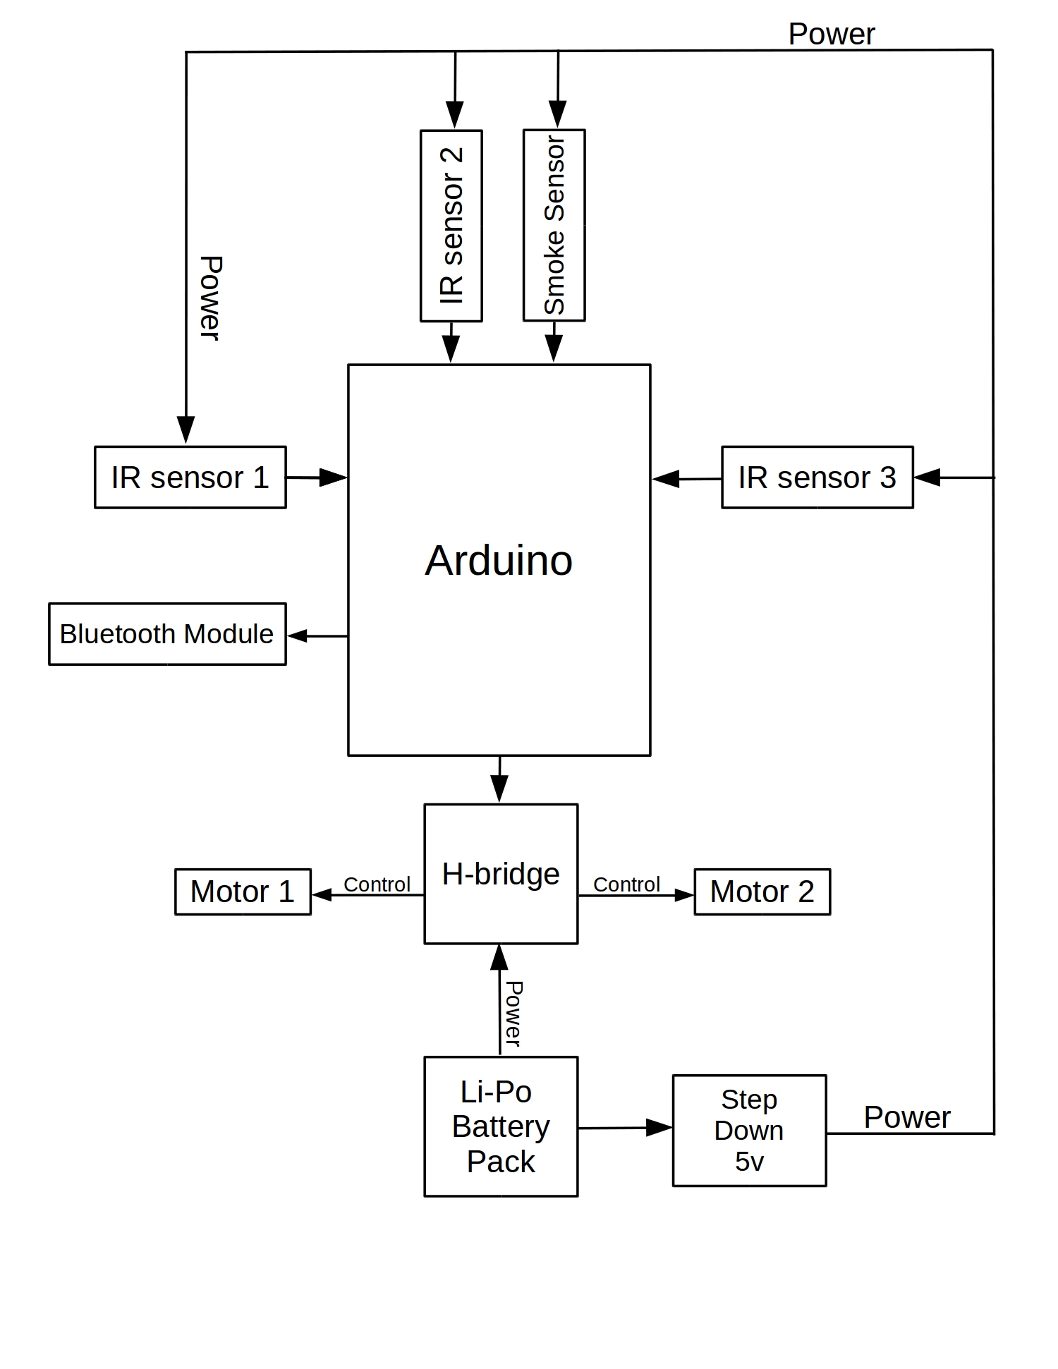
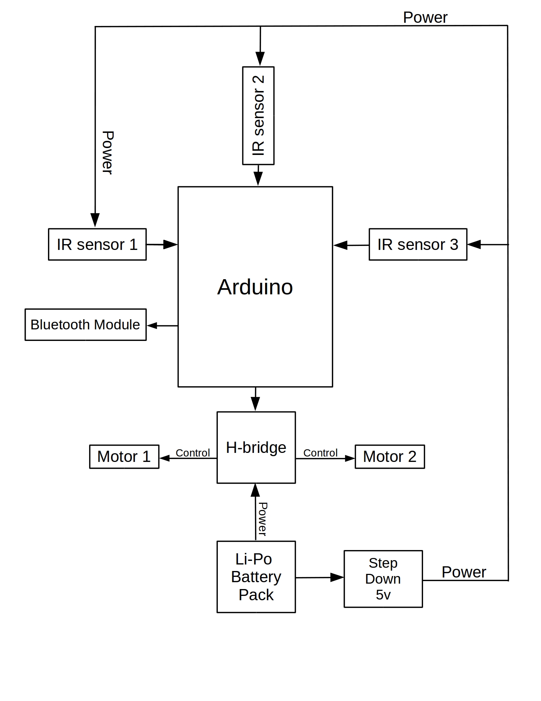
R O B O T S C H E M A T I C
First Robot
Second Robot
Notes:
1 – left wall
2 – junction detect

Slide 16
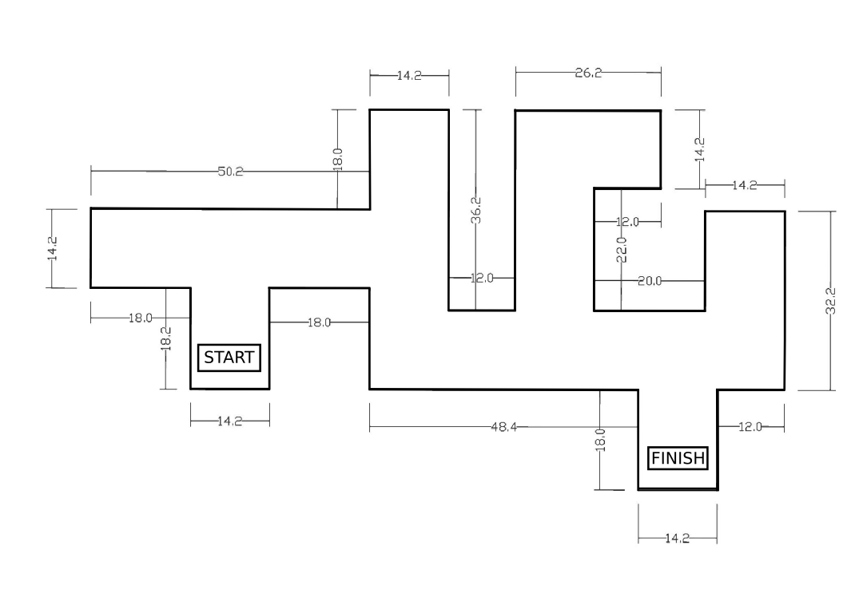
MAZE

Slide 17
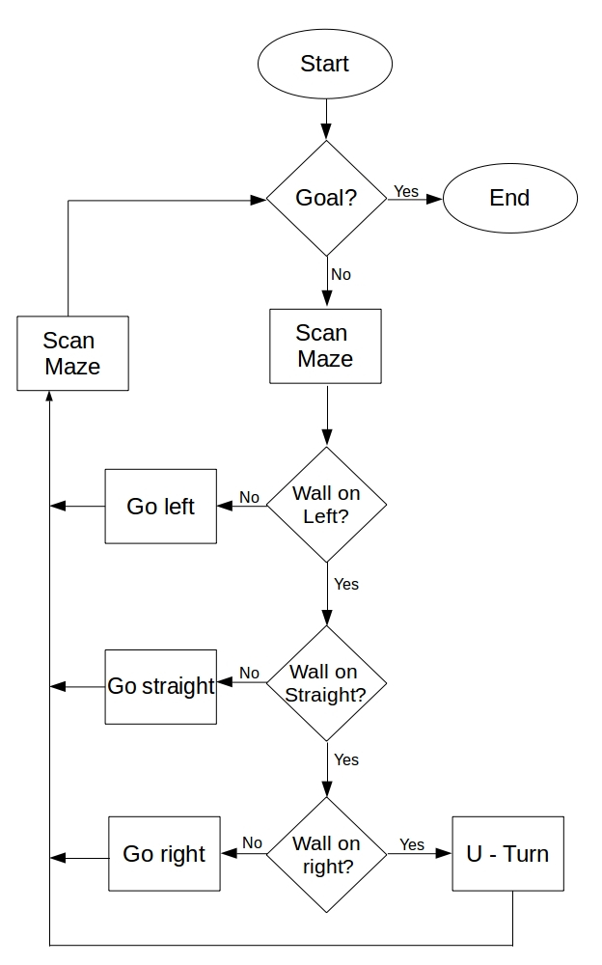
Left Wall Following Algorithm
Robot will reach the target by keeping track of the left wall
Priorities
Left
Straight
Right

Slide 18
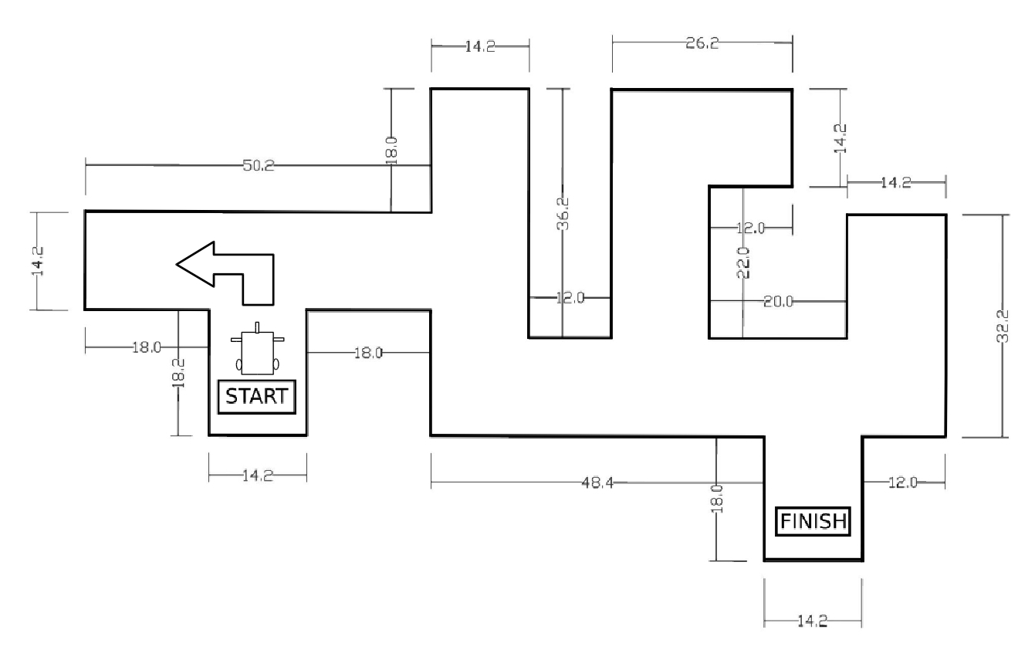

Slide 19
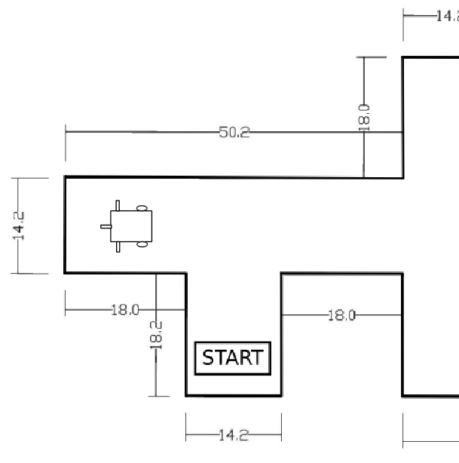
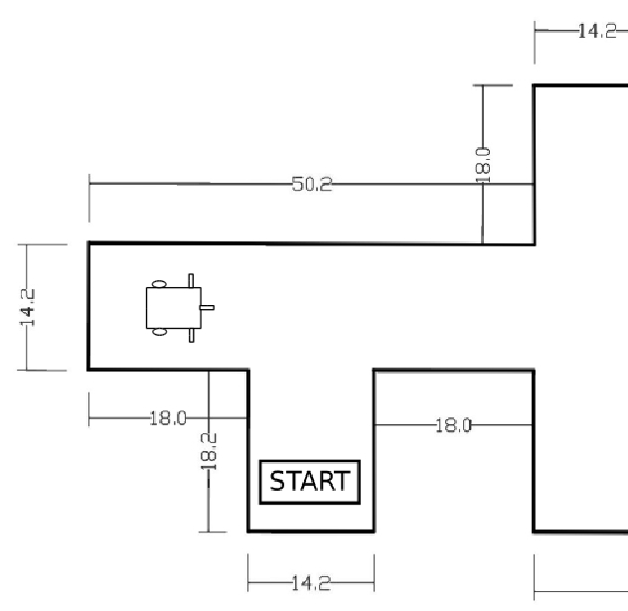

Slide 20
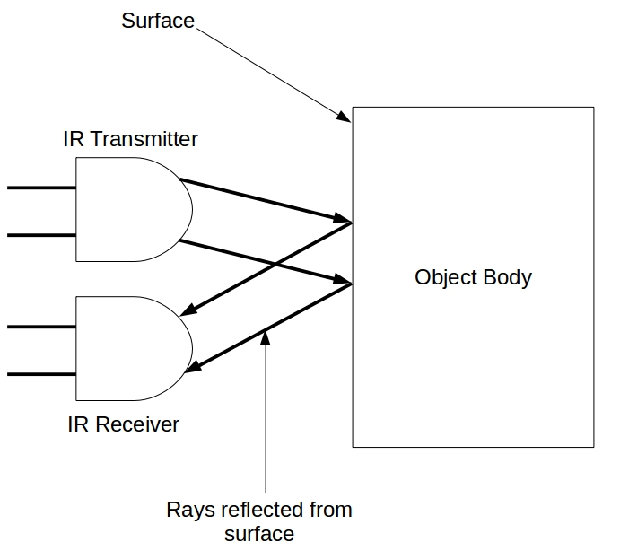
Detection Of The Wall
Detection Carried Out Through IR Sensors FC-51
IR Transmitter
IR Receiver

Slide 21
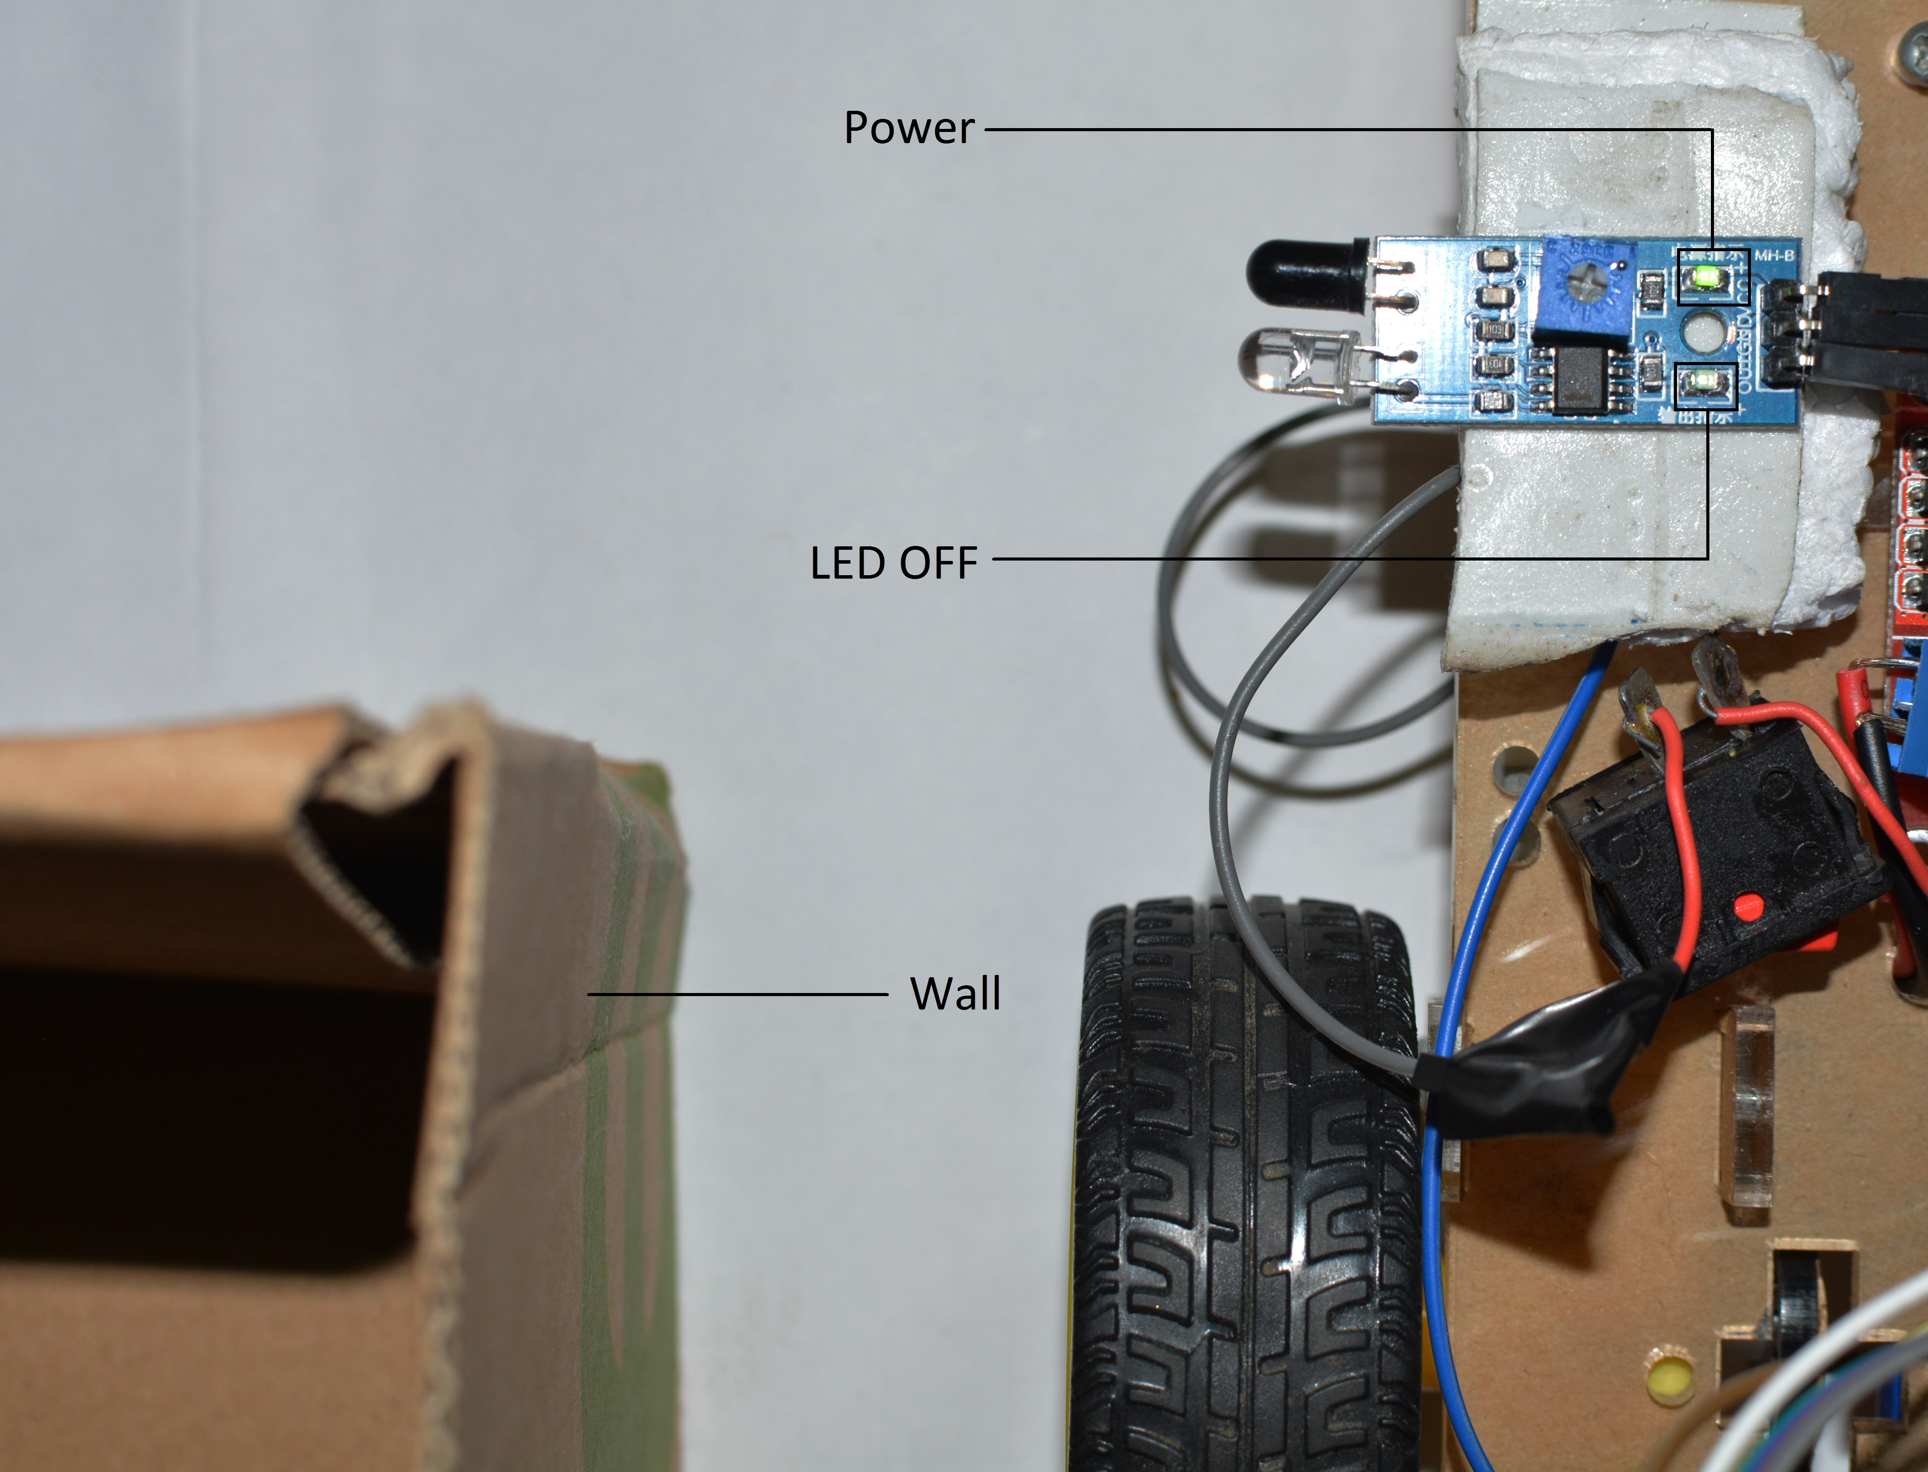
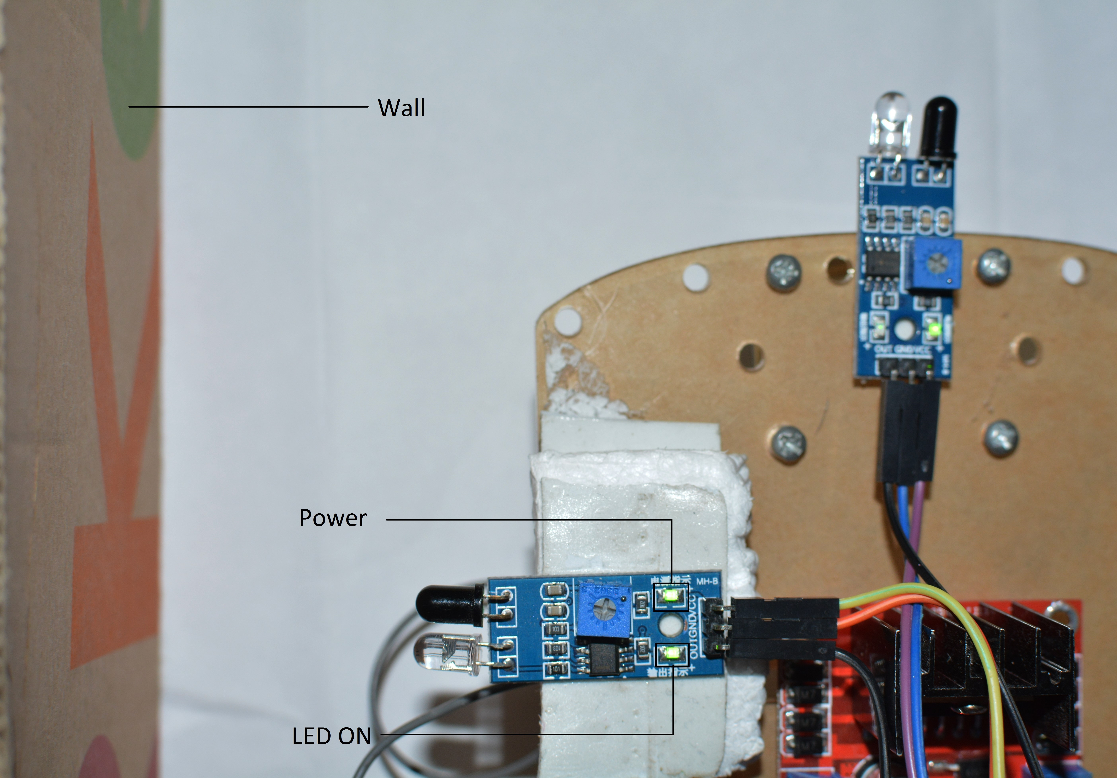
Detection of wall by the left sensor
No detection of the wall

Slide 22
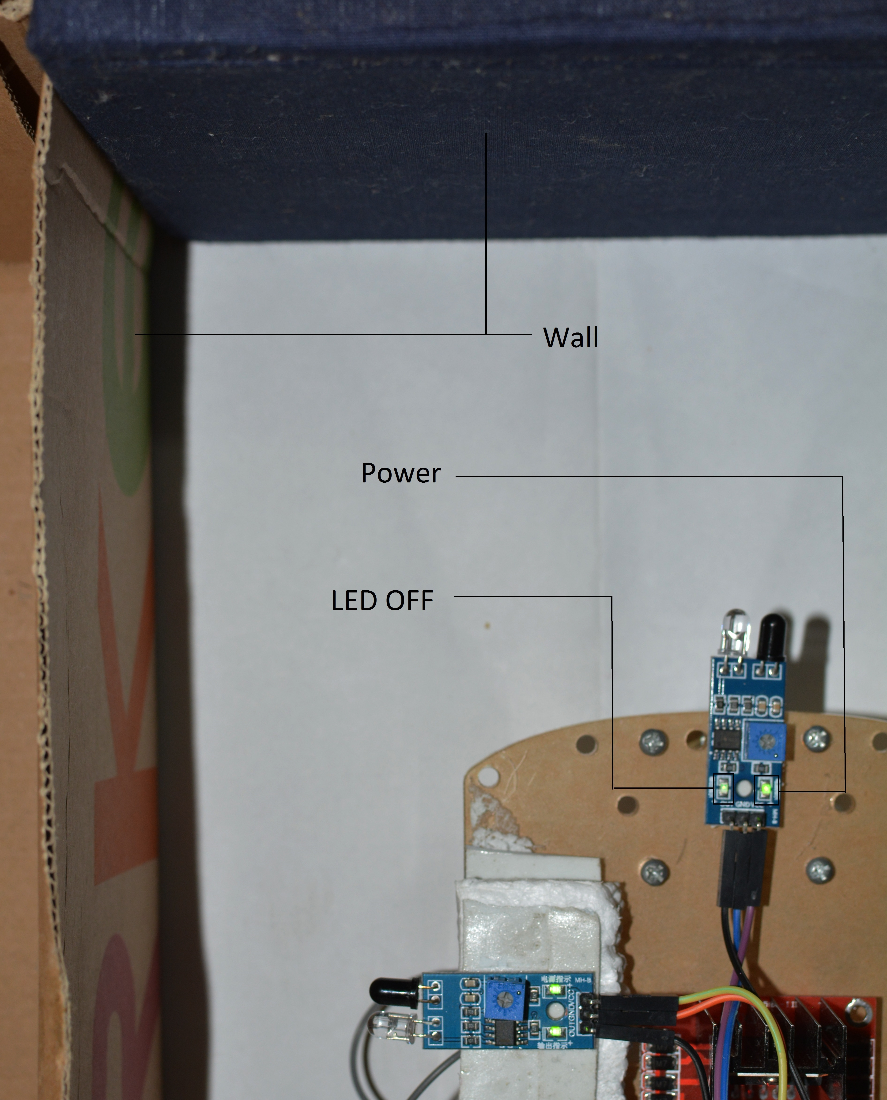
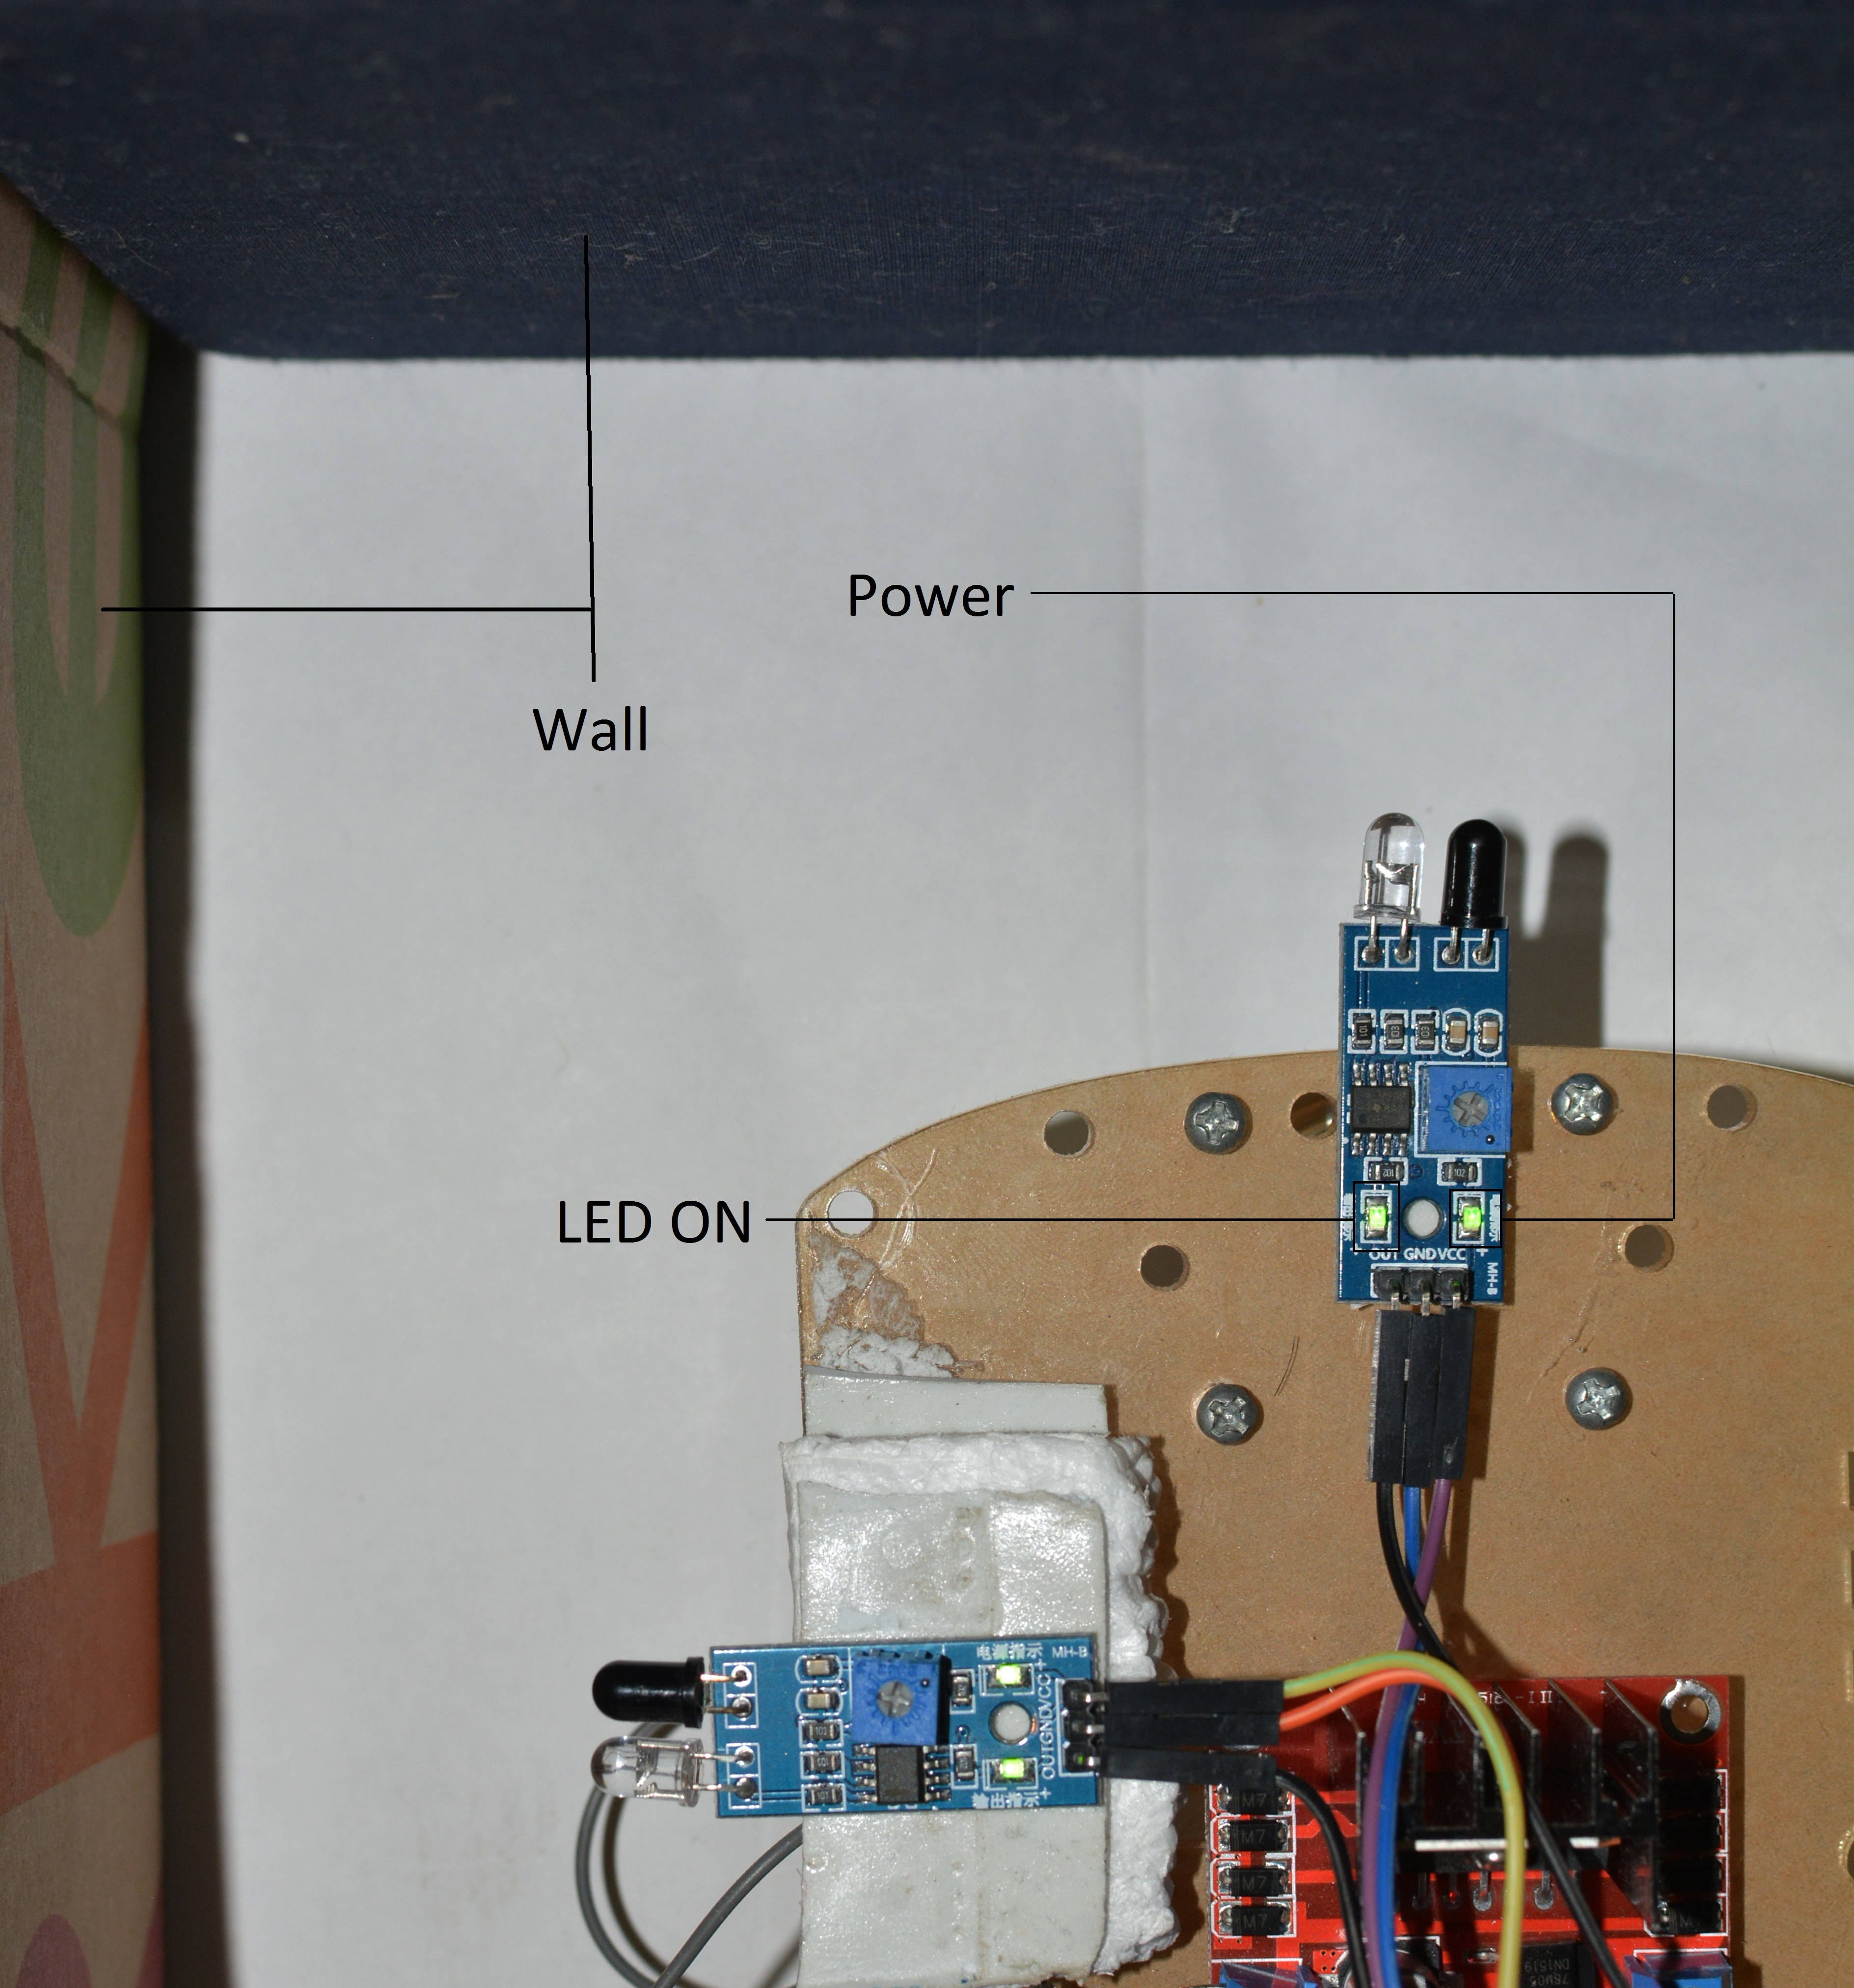
Detection of the front wall
No detection of the wall
by the front sensor

Slide 23
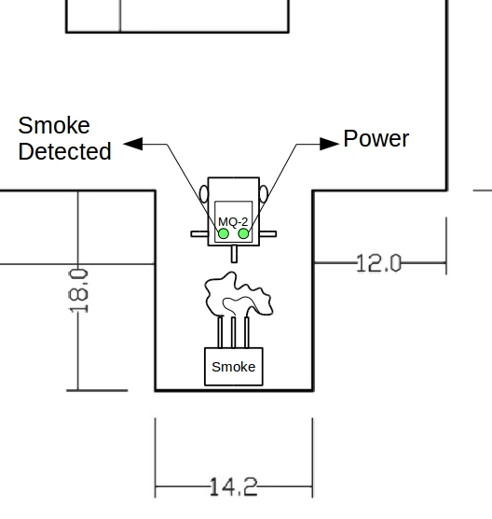
Target Detection
Target : Smoke
Adjustment : Potentiometer

Slide 24
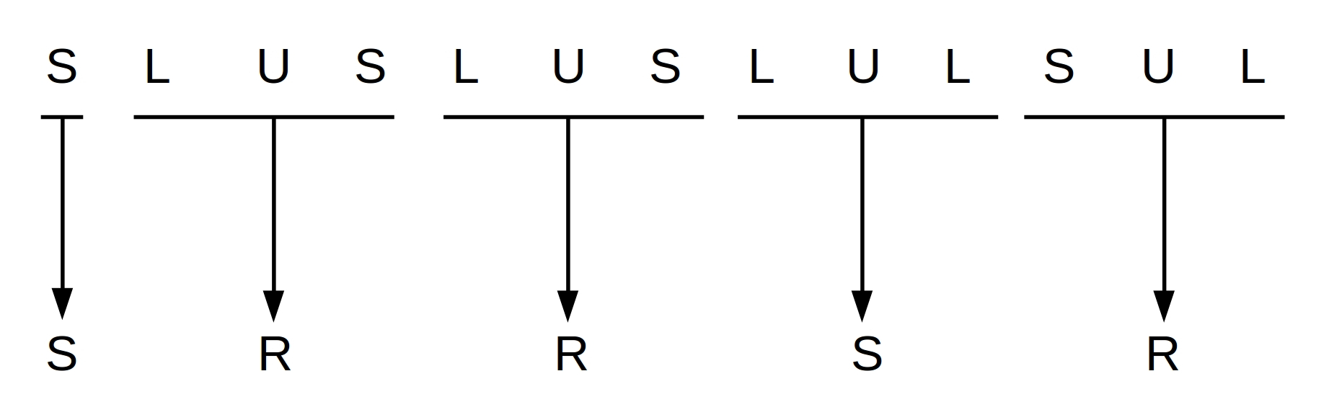
INTELLIGENCE
For the given maze, the path followed by the first robot and the shortest possible path
The decisions taken by the first robot at various junctions
The optimal decisions required for shortest path.

Slide 25
WIRELESS COMMUNICATION (BLUETOOTH)
Two HC-05 used as master and slave.
The decoded message sent by the first robot to the second
S | R | R | S | R

Slide 26
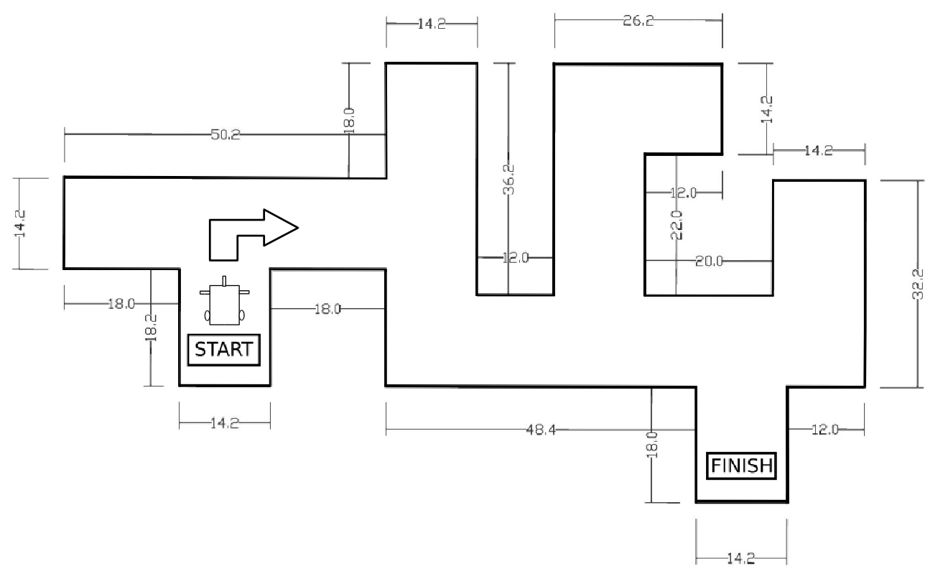
PATH TRAVERSED BY SECOND ROBOT

Slide 27
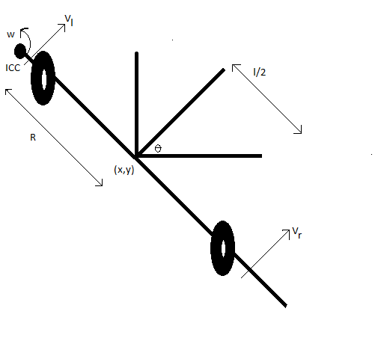
DIFFERENTIAL KINEMATICS
Consists of 2 drive wheels
Has high degree of freedom i.e. 4

Slide 28
Pulse Width Modulation (PWM)
Encodes message to the pulsing signal.
Generated by microcontroller
H-BRIDGE: Interface between microcontroller and motor

Slide 29
Results

Slide 30
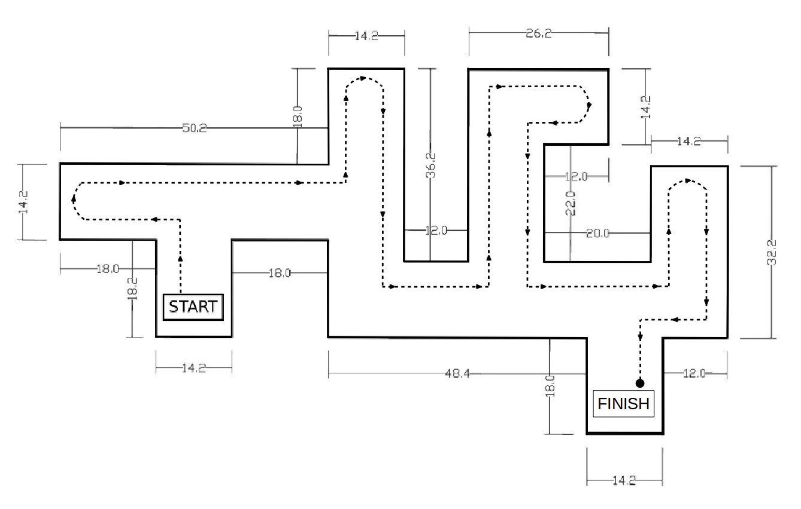
The overall path followed by the first robot

Slide 31
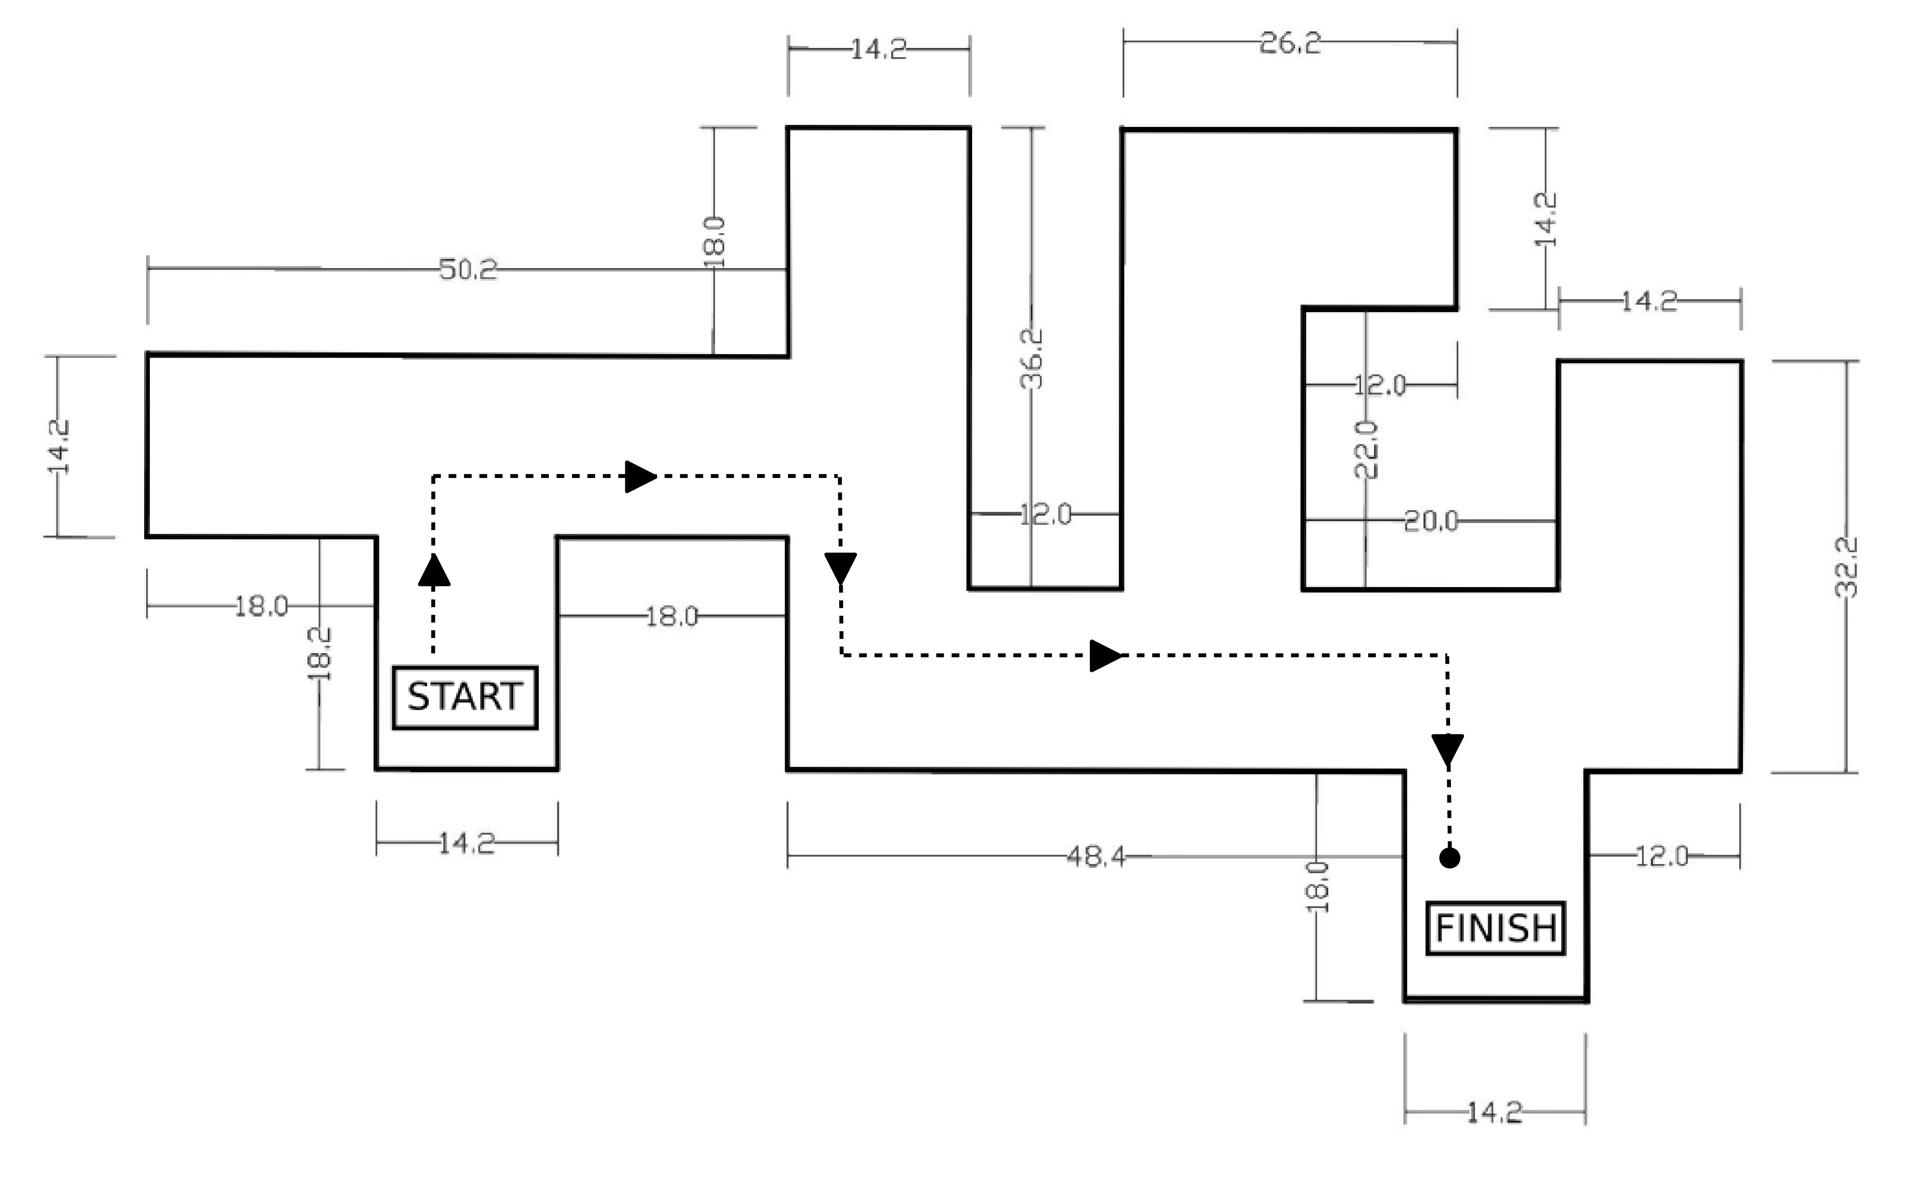
The overall path followed by the second robot i.e. shortest possible path

Slide 32
CONCLUSION
The maze was solved
Concept of swarm intelligence was visualized
Wireless Communication was established

Slide 33
REFERENCES
B. W. D.H. Barnhard, J.T. McClain and W. Potter, “Odin and hodur: Using bluetooth communication for coordinated robotic search,” The University of Georgia, Tech. Rep.
B. F. V. Gazi, “Coordination and control of multi-agent dynamic sys-tems: Models and approaches,” in Swarm Robotics, Springer, 2007, pp. 71–102.
S. P. Y. Mohan, “An extensive review of research in swarmrobotics in nature and biologically inspired computing,” World Congress on, IEEE, vol. 1, pp. 140–145, 2009.

Slide 34
THANK YOU

